Slide 1
Movie Database
By Cache Money

Slide 2



Topic Introduction

Slide 3
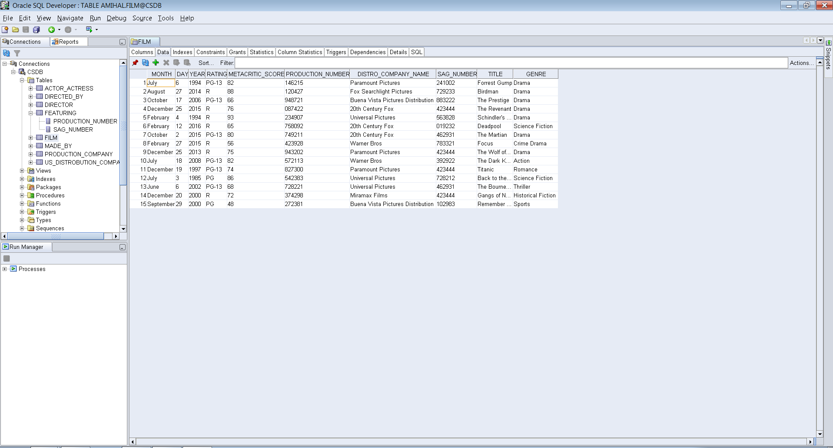
Database

Slide 4
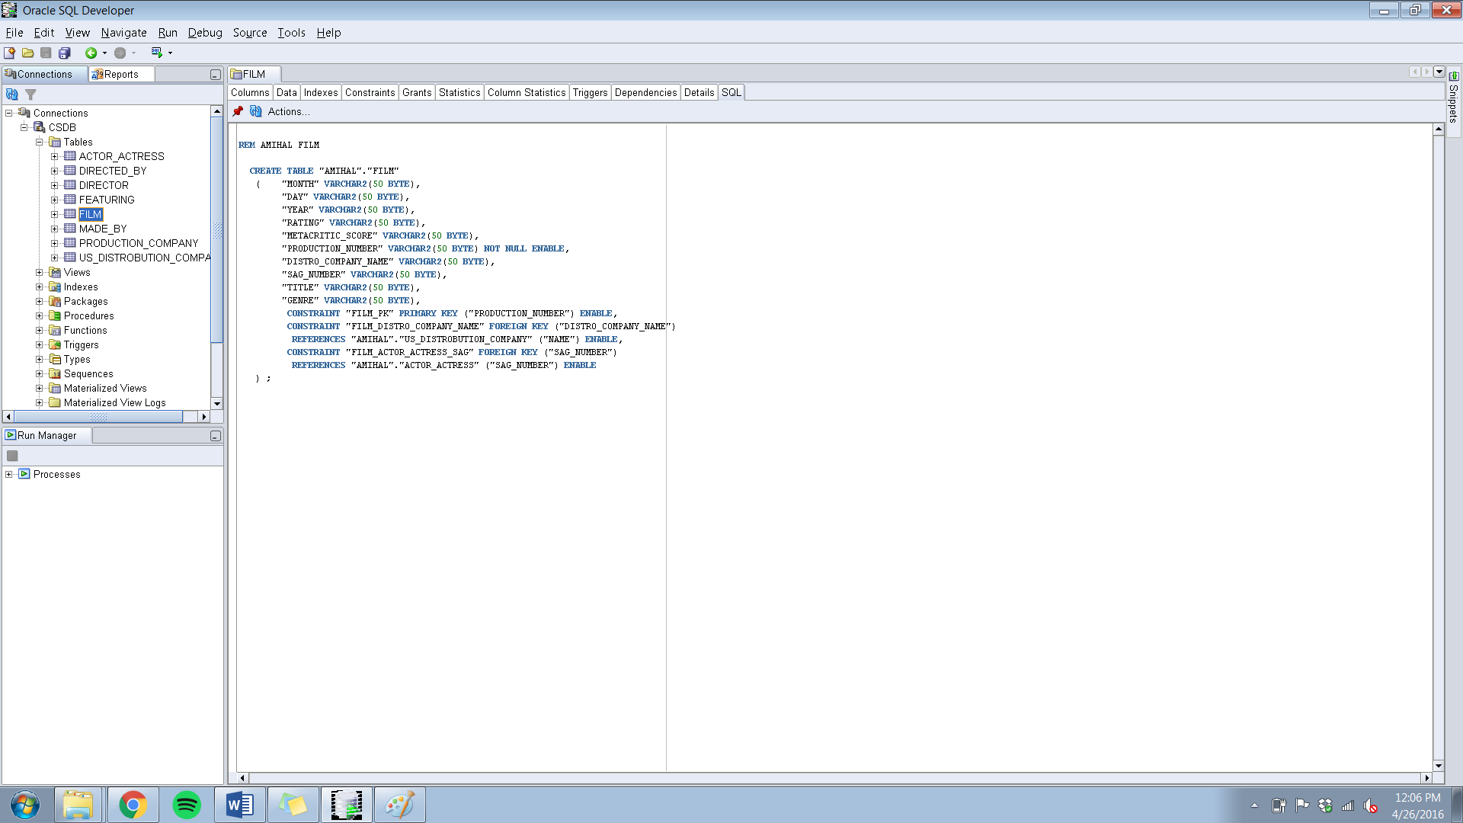
SQL Code

Slide 5
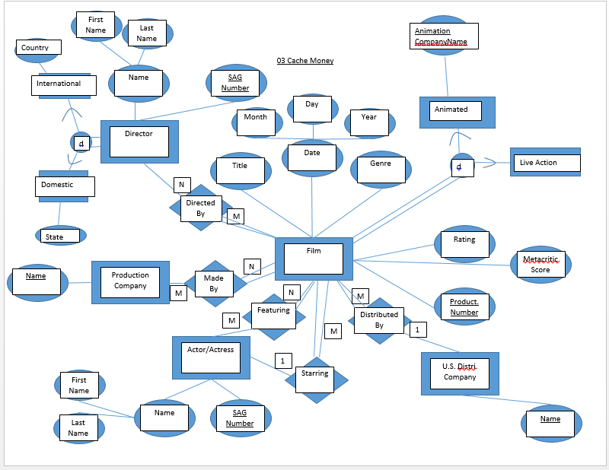
ER Model

Slide 6
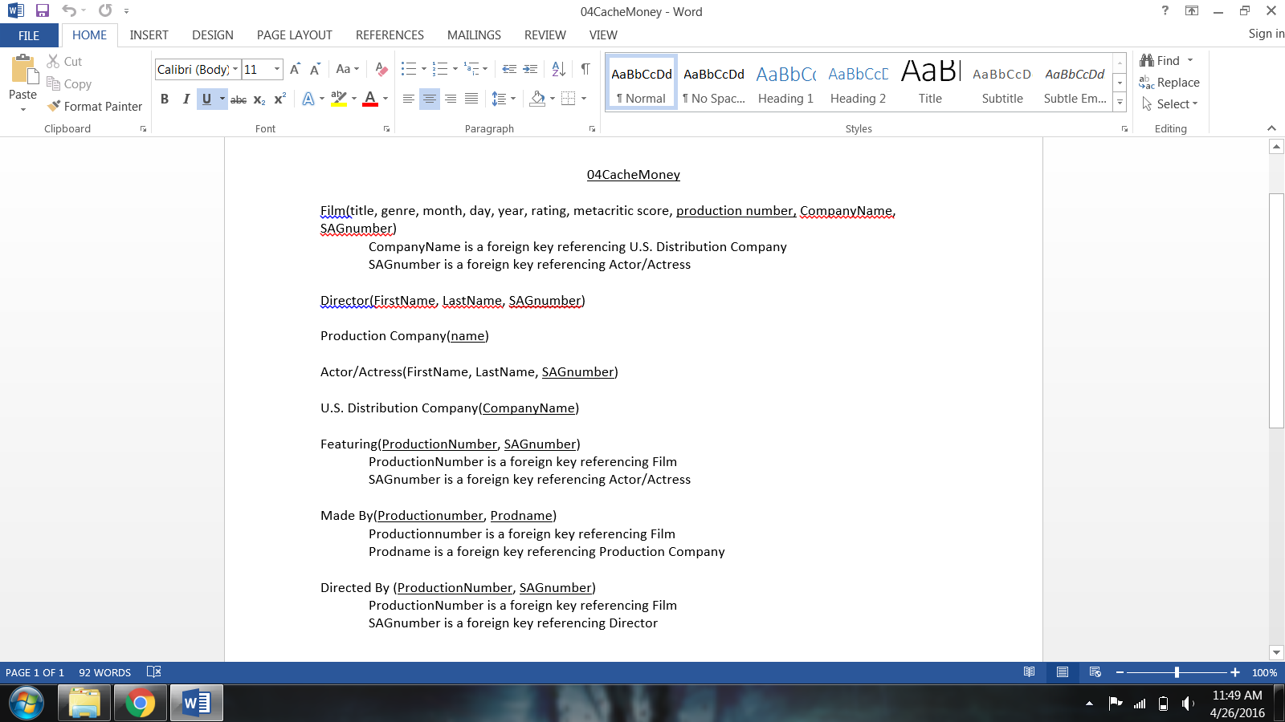
RDB Schema

Slide 7
Sample Queries
1. List the names of lead actors or actresses who have been in movies with critic scores greater than 80
Select name
From Film F, Actor_Actress A
Where A.SAG_Number = F.SAG_Number AND Metacritic_Score > 80
2. List the SAG Numbers of directors who have directed action movies
Select F.SAG_Number
From Director D, Directed_By DB, Film F
Where D.SAG_Number = DB.SAG_Number AND DB.Production_Number = F.Production_Number AND Genre = 'Action'

Slide 8
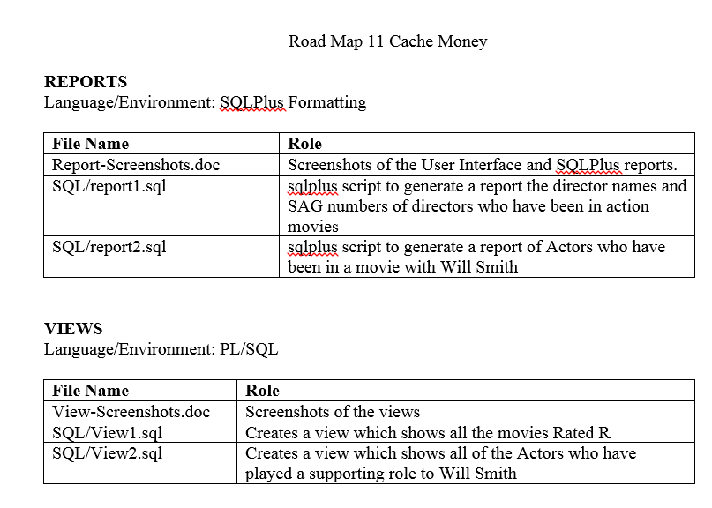
Road Map

